Slide 1
General Practice referral to the NHS Community Pharmacist Consultation Service (CPCS)

Slide 2
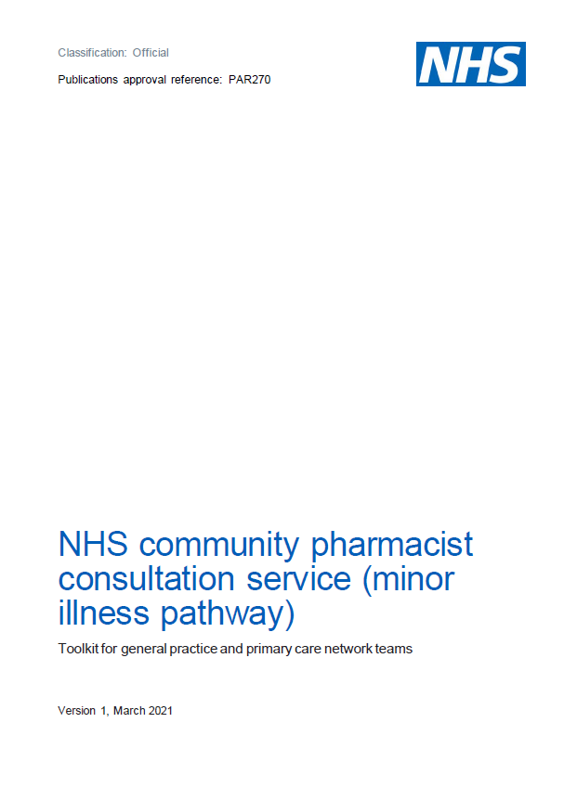
Presentation overview
What is the CPCS (GP referral pathway)?
Findings from the GP referral pilots
How does the referral process work?
Referral routes to pharmacy
Examples of low acuity conditions for referral
Key points for local consideration
NHS resources
Questions

Slide 3
What is the CPCS (GP referral pathway)?
It follows on from the success of NHS CPCS referrals from NHS 111 for minor illness and urgent medicines supply in October 2019
An additional referral pathway into the service for minor illness was agreed as part of the Year 2 Community Pharmacy Contractual Framework (CPCF) deal
GP CPCS became part of the national service on 1st November 2020
To support low acuity conditions only – there are no GP referrals for urgent supply of medicines or appliances
It is estimated that 6-8% of all GP consultations could be safely transferred to a community pharmacy for management of minor illness
This could equate to around 55 appointments per GP practice each week
It is a digital referral for a patient with a low acuity condition from a general practice to a community pharmacy saving an appointment at the practice for a minor illness assessment

Slide 4
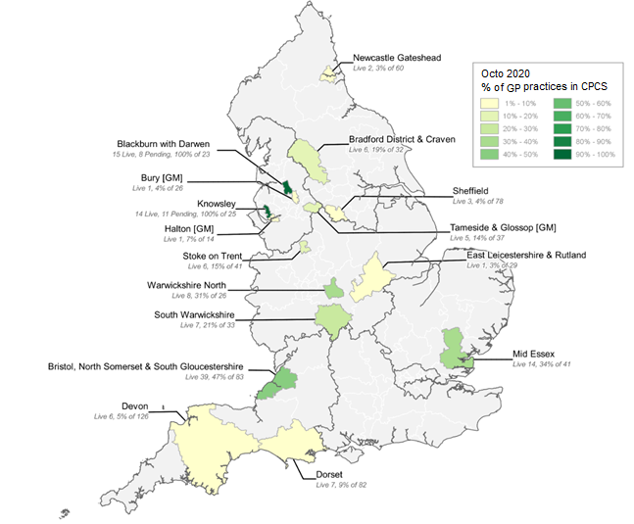
Piloting the GP referral pathway
Pilots were run across the country to test the GP referral pathway
Practices were able to refer a defined list of symptom groups to the participating pharmacies
The triage and referral mechanisms at the practices varied across the pilot sites
A number of pilots were run across the country to test the gp referral pathway. Pilots areas were able to refer for a defined list of symptom groups as part of NHS CPCS and utilise a mixture of digital tools to deliver the service.
The pilot sites
The pilot in numbers
Pilot sites were on-boarded in three tranches
Following demand from individual practices, tranche 3 sites proactively signed up to the pilot post COVID wave 1 (summer 2020)
5 regions piloted the referral pathway across 19 CCGs and 47 PCNs
10 pilot areas were made up of 126 GP practices, 262 pharmacies and 1 hub
9,551 referrals were made, with 88% of referrals completed by the pharmacist
There were 2 evaluations undertaken focusing on patient experience and GP practice staff/pharmacy feedback with 84 feedback interviews and over 250 completed surveys returned
97% of patients said they would use the service again

Slide 5
Key findings from the evaluations
GP practice staff | The role of the reception staff “care navigator” was seen as key in ensuring the adoption of the pathway through the use of steaming and simple protocols to identify patients for referral. | Understanding the value of the pathway to the practice as a whole was important to reinforce why reception teams choose NHS CPCS over an appointment with a member of the practice staff. | Practice staff were positive about the GP referral pathway to NHS CPCS, with 91% of respondents indicating they would recommend this service to other GP practices and 95% that they would recommend the service to friends and family. | Regular updates, refresher training, additional support materials and training on any new processes were suggested as key processes for any implementation of the service. | Respondents highlighted that good communication between GP practices and community pharmacies is very important to support a streamlined service to ensure pharmacists are regularly reporting back any issues with the referral process and practice staff to work closely with pharmacy staff to ensure patients are supported.
Pharmacist feedback | Data from pharmacies shows that 86% of people referred attended the pharmacy for a consultation. This was compared with findings for the NHS 111 referral pathway that showed a 61% attendance rate at the time of the evaluation. | The need to increase patient awareness of the services that pharmacies can provide was highlighted. | 73% of respondents indicated that the process of arranging appointments with referred patients fitted in with their daily processes very or fairly well. | The pathway is working well and has been received well by patients and staff – that is down to good communication. | Time is allocated to deal with these patients. The service is convenient for patients and the pharmacy.
Patient experience | Reassurance about the service, the clinical skills of the pharmacist and the escalation routes were identified as important to patients. | Patients cited convenience, time-savings, and being able to fit appointments around working hours as reasons to use the service again. | Patients had varying expectations of the pharmacist, primarily because they were using the service for the first time and so were unsure what to expect. | 99% of patients said they were mostly satisfied with the amount of time given for discussion with the pharmacist; 89% were definitely satisfied with the consultation and discussion; and 88% had confidence in the pharmacist they spoke to. | Overall the findings suggest that patients’ needs are being met by the service as the majority did not have to subsequently use an NHS or non-NHS service for the same ailment and were positive about the pilot.

Slide 6
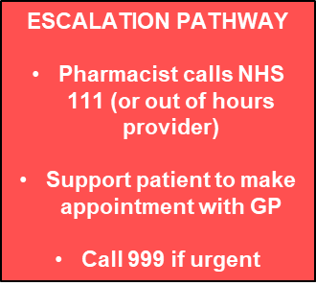
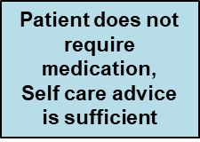
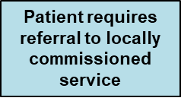
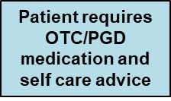
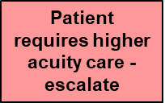
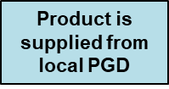
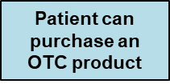
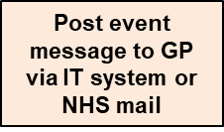
How does the referral process work?
Patient calls or attends their GP practice with a minor illness
Patient triaged and referred to a nominated community pharmacy
Message sent to community pharmacy electronically
Either by integrated IT system / standalone IT form / via NHSmail

Slide 7
Referral routes to pharmacy
Referral information MUST be sent via a secure digital route – verbal/telephone referrals are not allowed
Referral information consists of patient demographic information, patient contact details and the reason for the referral – the GP/PCN toolkit & implementation checklist provide an example template which can be used
Local solutions can be used to send the referral information to pharmacy with NHSmail being the minimum viable product (MVP) required to send referral information to pharmacy
Once a patient has been triaged for an NHS CPCS consultation the referral may be sent in one of three ways:
NHSmail
Standalone system
Integrated system
(e.g. GP clinical system)
Open up NHSmail
Complete referral template
Send email to pharmacy
Select pharmacy to send to
Open webpage/portal
Complete referral information
Select pharmacy to send to
Send referral to pharmacy
Click ‘refer’
Select pharmacy to send to
Click ‘send’ – referral sent to pharmacy

Slide 8
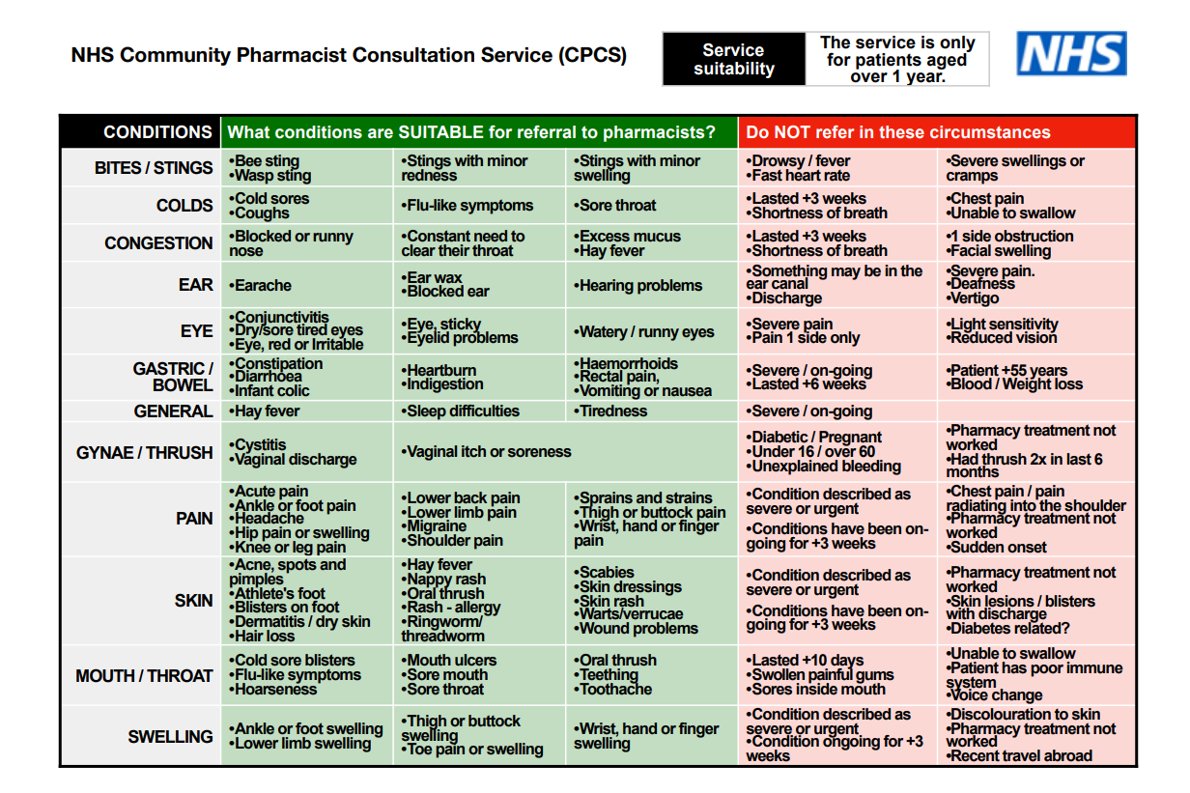
Examples of referrable low acuity conditions

Slide 9
Key points for local consideration
Successful implementation is underpinned by great collaboration and clear communication between all parties (The NHSE&I programme team , CCG leads, PCN Clinical Directors, PCN Project Lead, Practice Managers and practice teams, PCN Clinical Pharmacists, PCN Community Pharmacy leads, community pharmacy contractors and their teams, LMCs and LPCs.)
The local implementation team needs to agree a number of local arrangements before a GP practice ‘goes live’ including:
The referral method used by the GP practices in the PCN
Timescales for responding to a referral received by the pharmacy
Use of professional phone lines for direct contact with the GP practice
The local method of escalating patients back to the GP practice
Local feedback mechanisms to consider and respond to issues associated with the service
Pharmacies need the above agreed to finish writing their SOPs for the service
Clear communications are required with all community pharmacies and general practices within a PCN ahead of local ‘go lives’
Clear briefing and training plans for the appropriate members of the general practice teams

Slide 10
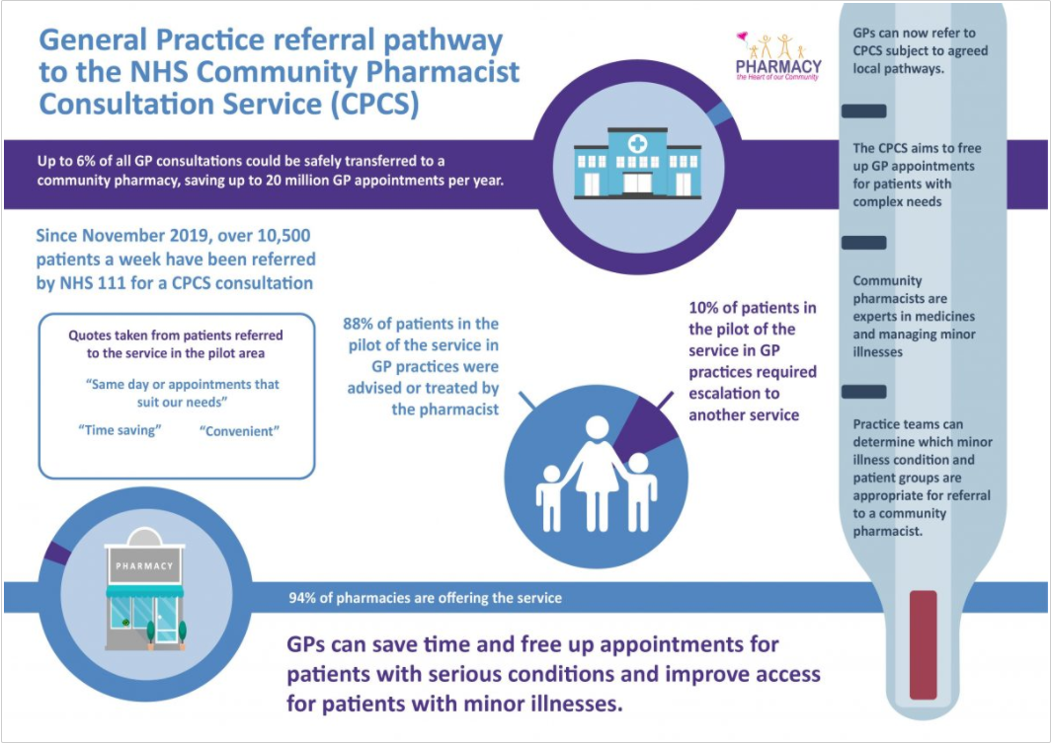
NHS resources
The GP/ PCN toolkit:
Aims and intended outcomes
A description of the GP Referral Pathway how it works and the patient journey
Process for making referrals including how the digital elements may work
Information included in the referral
PCN engagement and governance arrangements
Communications materials to help support practices in their messaging to patients
Tips for liaising with patients
Who is available to support
GP CPCS Platform in FutureNHS
Useful contacts
Resources for both general practice, PCN and pharmacy staff
Pilot information and case studies
Recordings of national webinars (RCGP, PCPA, PMA and NHSE&I)
Comms support and discussion forum
Pharmacy resources
NHS England and NHS Improvement website
FAQs: Useful answers to common questions, drawing on learning from pilots
Case studies:
GP CPCS case study
References:
NHS CPCS Service Specification and Pharmacy Toolkit – updated to reflect the additional referral route in
Digital Referral Information
Patient access video
Pharmrefer
GP and PCN Governance arrangements to support the GP referral pathway to NHS CPCS
Implementation Checklist: one page reference guide to help support implementation

Slide 11
Questions and discussion

